Slide 1

Case Study Demo
Saivarshini, Kashish, Samruddhi,
S4 Move
8th September, 2020

Slide 2
Contents
Problem Statement
ER Diagram
Data Dictionaries and Sample Content
CDS Views
Determinations and Validations
Quick Demo
Application Screenshots
Future Implementations
Acknowledgements

Slide 3
Problem Statement

Slide 4
Problem Statement - Case 1
An employee should be able to log in time for a date in a simple format.
He/she should be able to perform basic CRUD operations.
The date should be a valid date:
Should not be a Public Holiday.
The employee shouldn’t have an approved leave on that date.
In case the date isn’t valid, the employee is not allowed to log his/her time.

Slide 5
Problem Statement – Case 2
Employee can request for leave.
He/she should be able to see their previous leave requests and their statuses.
Manager should be able to view leave requests.
Manager has the right to reject/approve leave requests.

Slide 6
ER Diagram

Slide 7
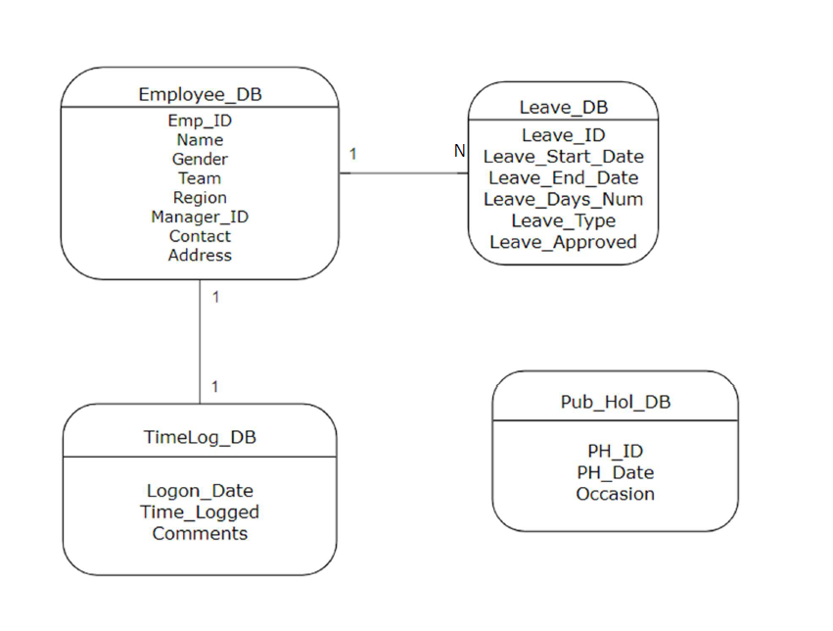

Slide 8
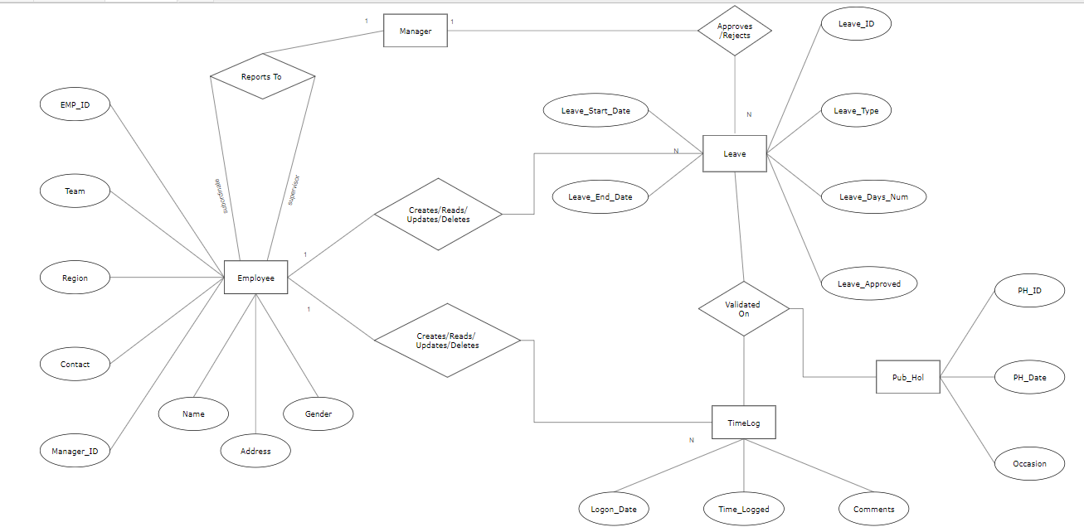

Slide 9
Data Dictionaries and Mock Content

Slide 10
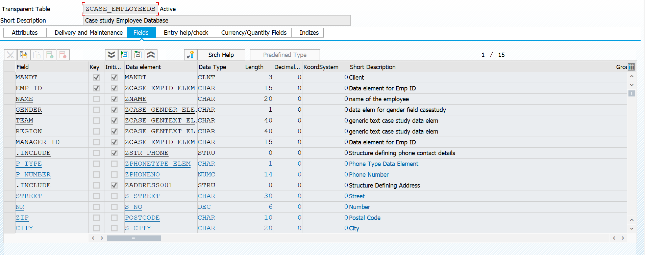
Employee DDIC (ZCASE_EMPLOYEE_DB)

Slide 11
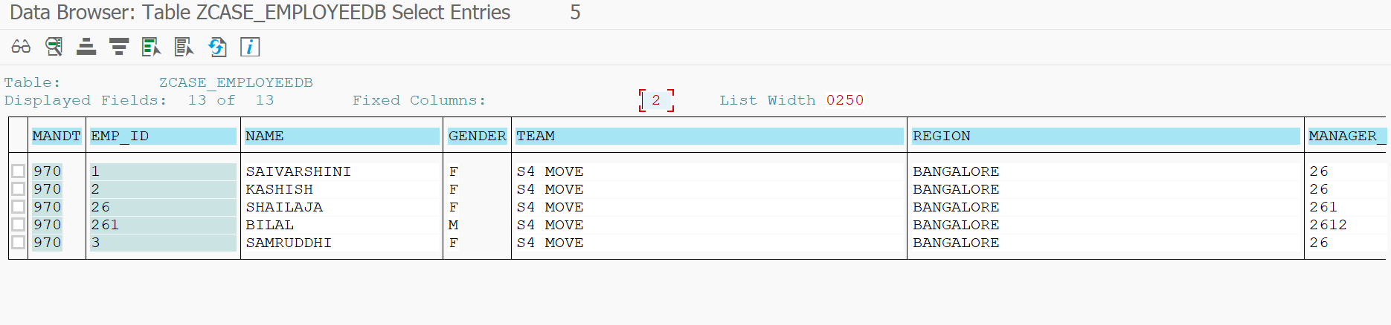
Employee DDIC Sample Content

Slide 12
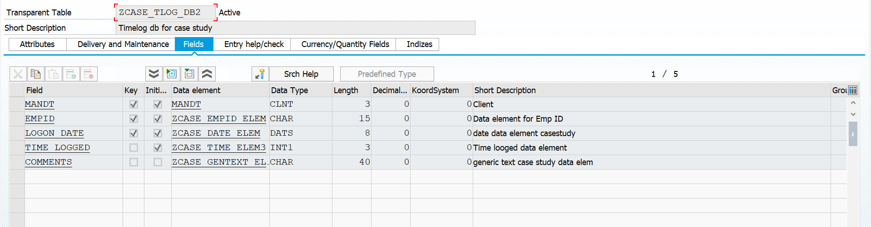
Time Log DDIC (ZCASE_TLOG_DB2)

Slide 13
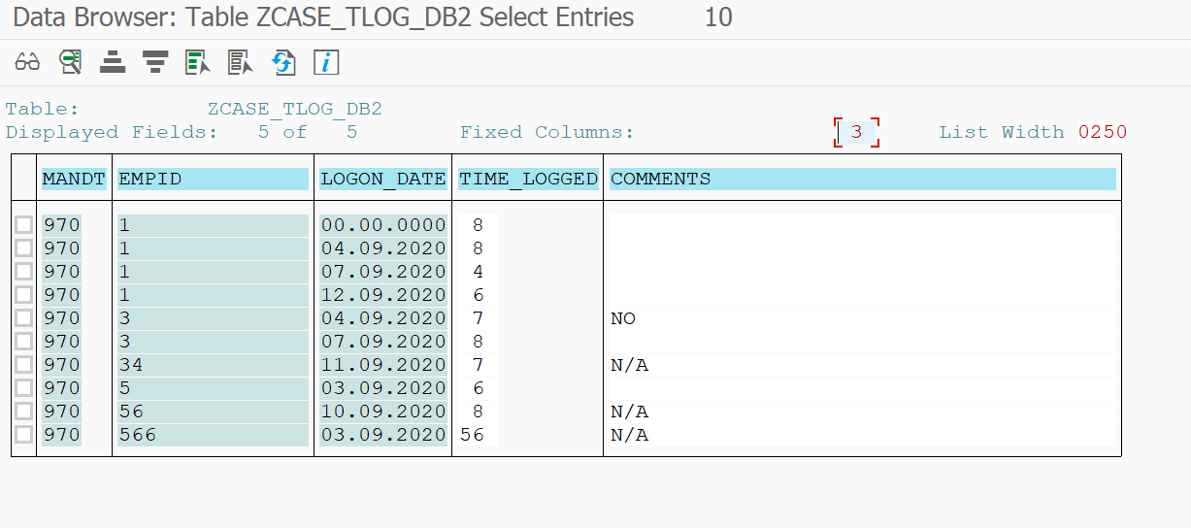
Time Log DDIC Sample Content

Slide 14
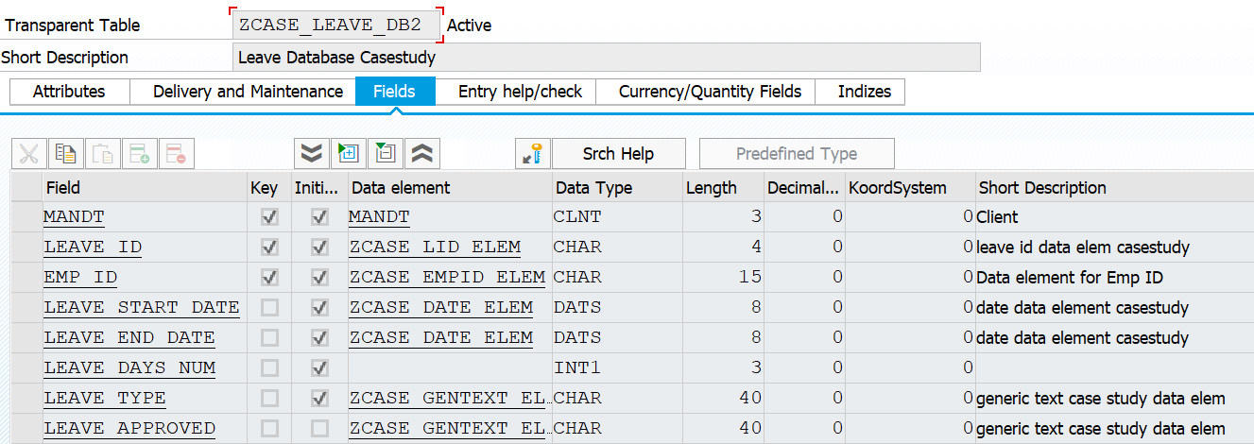
Leave DDIC (ZCASE_LEAVE_DB2)

Slide 15
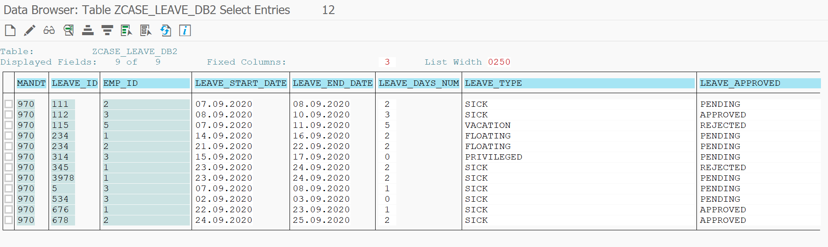
Leave DDIC Sample Content

Slide 16
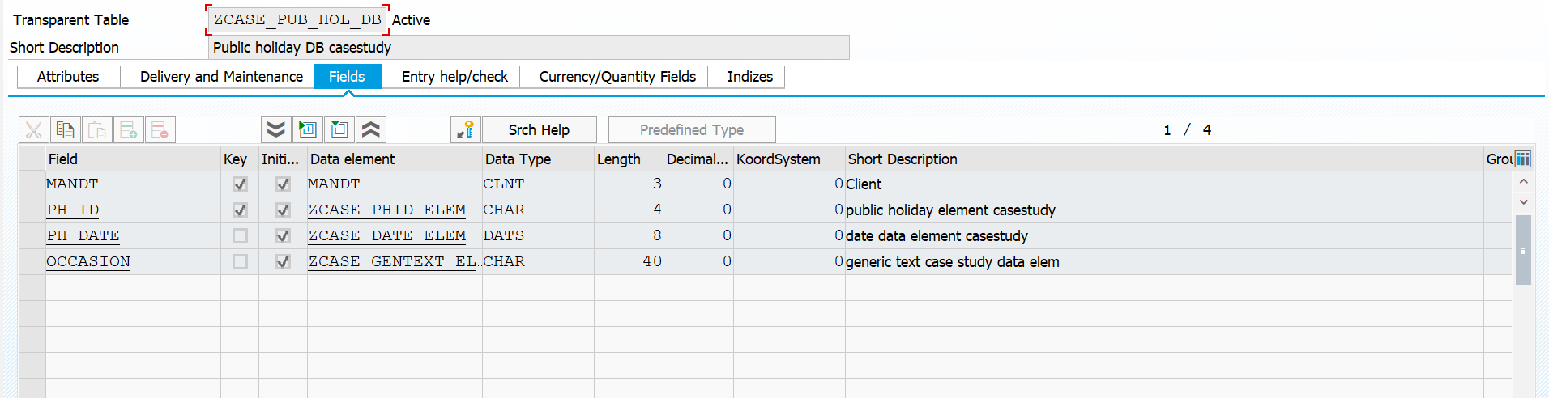
Public Holiday DDIC (ZCASE_PUB_HOL_DB)

Slide 17
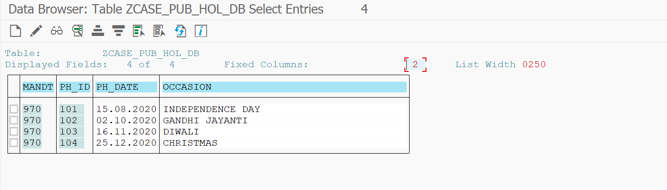
Public Holiday DDIC Sample Content

Slide 18
CDS Views

Slide 19
Manager Leave Approval Portal
Basic View | Transaction View | Consumption View
ZCASE_LAP_EMP_BASE | ZCASE_LAP_EMP_TP | ZCASE_LAP_EMP_CV
ZCASE_LAP_LEAVE_BASE | ZCASE_LAP_LEAVE_TP | ZCASE_LAP_LEAVE_CV

Slide 20
Employee Leave Application and Time Log Portal
Basic View | Transaction View | Consumption View
ZACT_EMP_BASE | ZACT_EMP_TP | ZACT_EMP_CV
ZACT_LEAVE_BASE2 | ZACT_LEAVE_TP2 | ZACT_LEAVE_CV2
ZACT_TIMELOG_BASE2 | ZACT_TLOG_TP2 | ZACT_TLOG_CV2

Slide 21
Determinations and Validations

Slide 22
Determinations
Auto Generation of Leave Id.
Auto Generation of Leave Status.
Auto Calculation of Number of Days of Leaves applied for.
Retrieval of Emp_ID from the parent to child nodes.

Slide 23
Validations
Error Message -001 : User can't apply for leaves on Public Holiday.
Error Message -002 : User not allowed to log time on Public Holidays.
Error Message -003 : User not allowed to log time on Approved Leave Dates.
Error Message -004 : User must enter Leave Start Date on or before Leave End Date.

Slide 24
Quick Demo

Slide 25
Application Screenshots

Slide 26
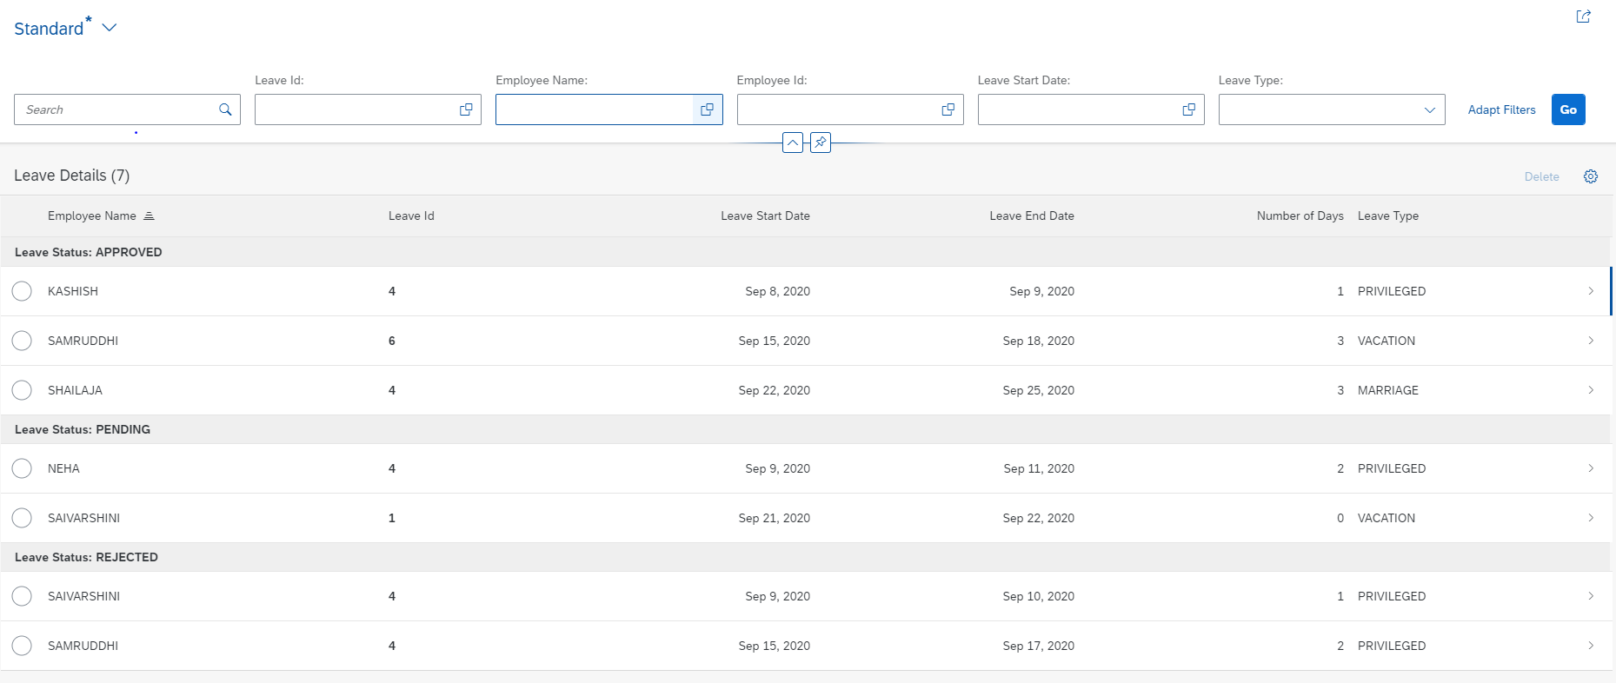
Manager Leave Approval Portal

Slide 27
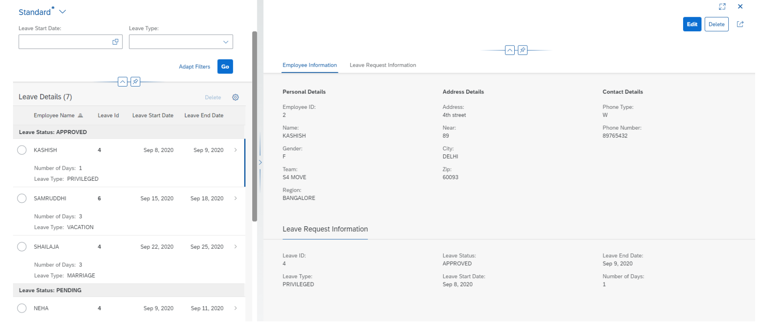

Slide 28
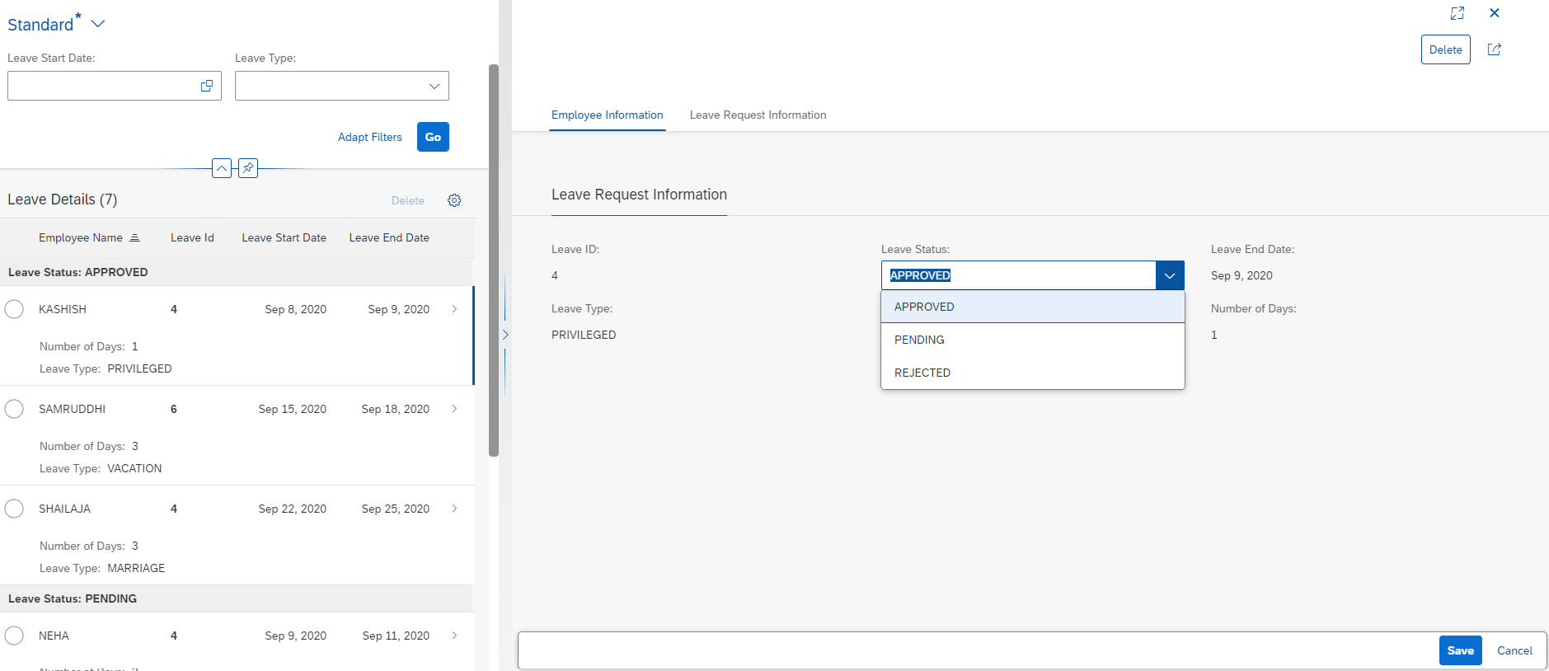

Slide 29
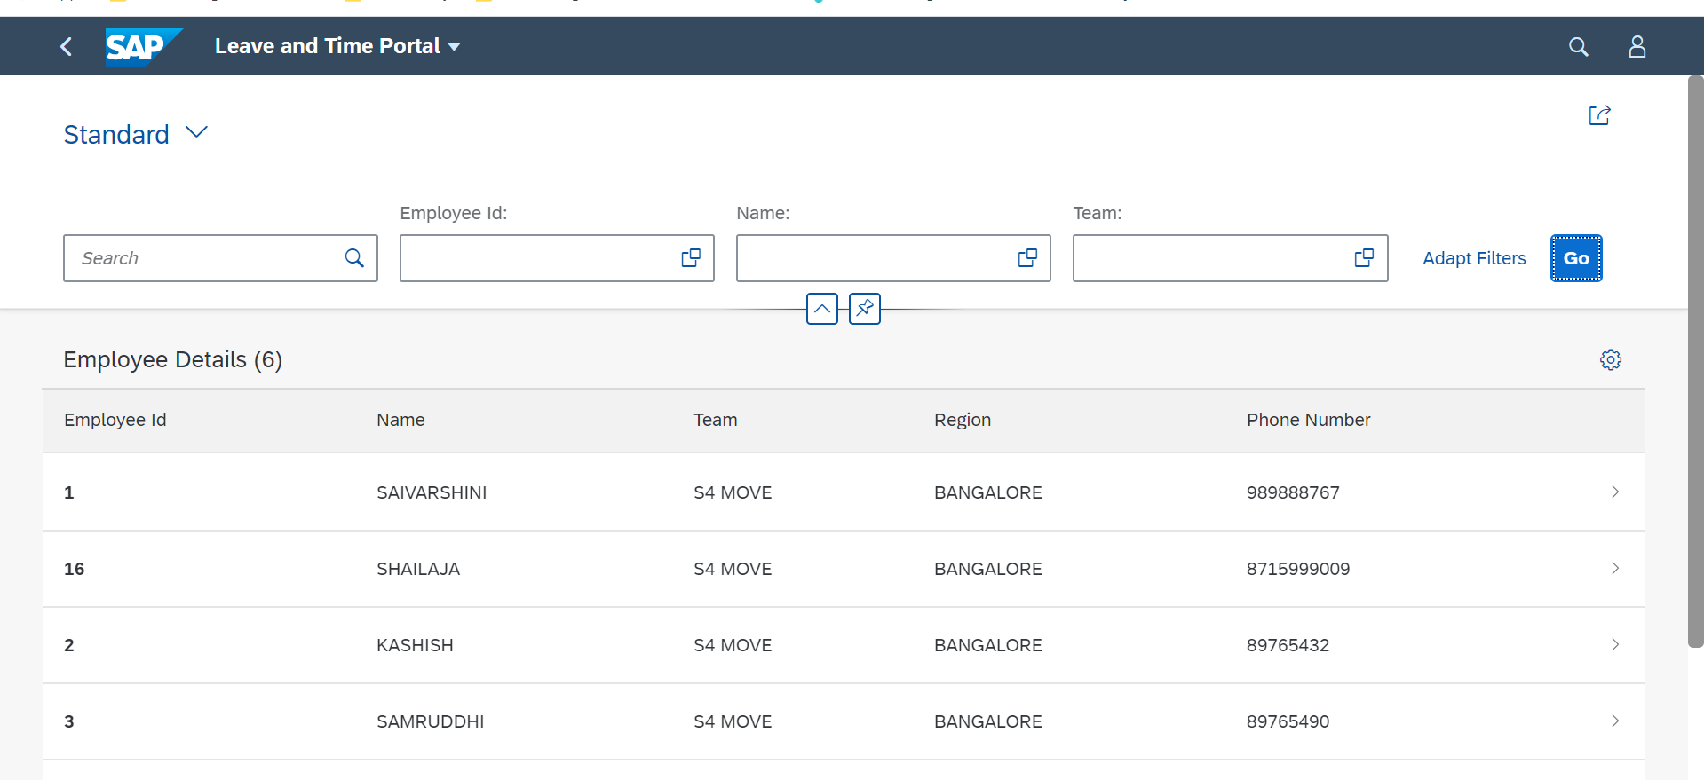
Leave Request and Time Log Portal

Slide 30
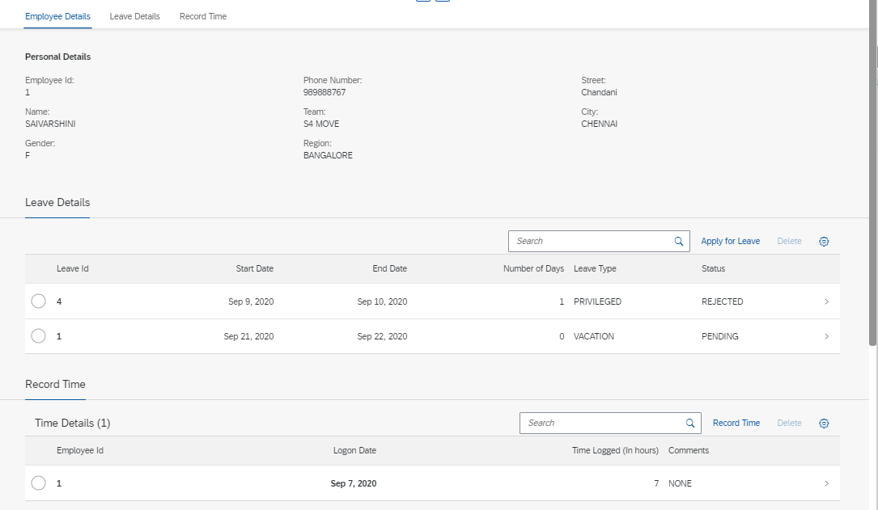

Slide 31
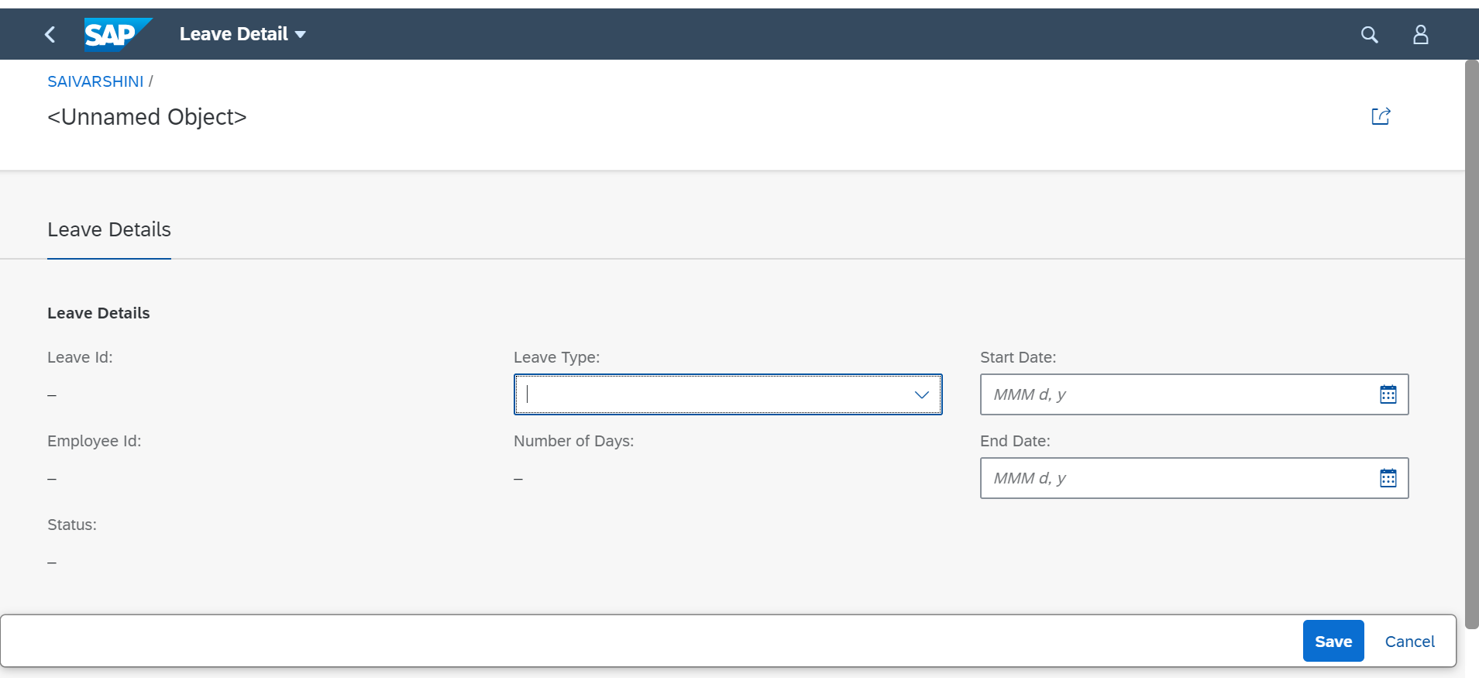

Slide 32
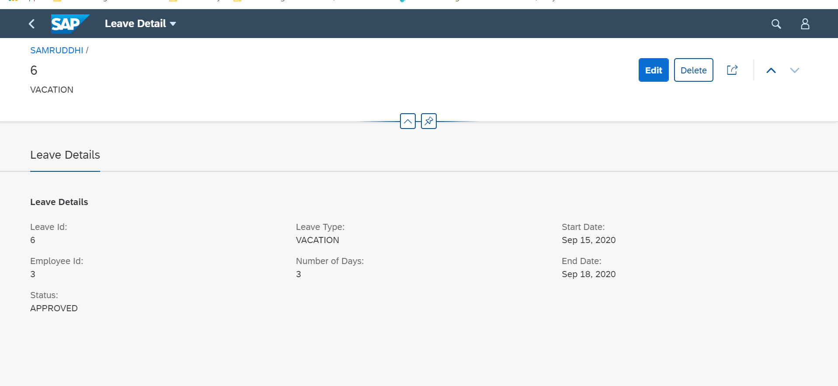

Slide 33
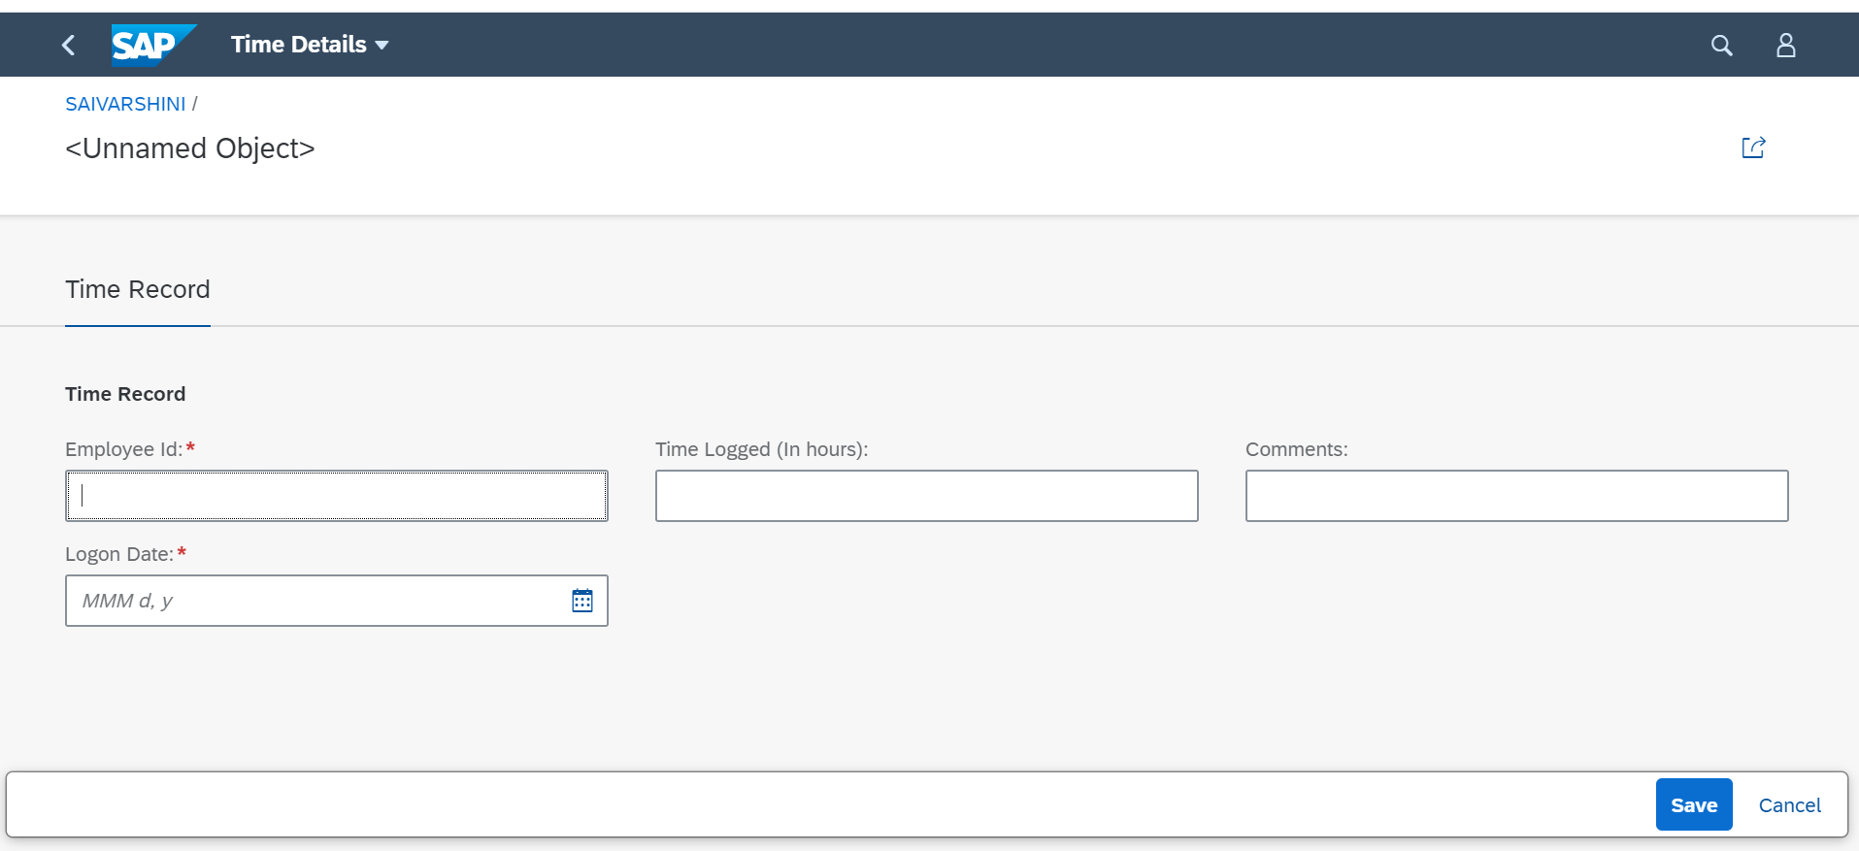

Slide 34
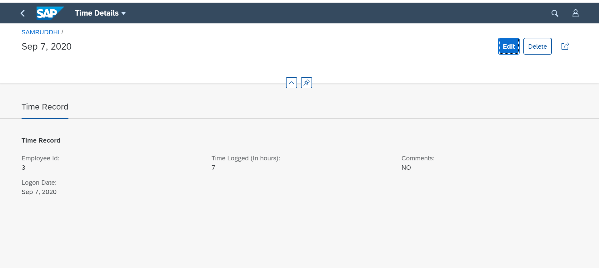

Slide 35
Future Implementation
Notes:
That’s all from the demo side
Moving on to the future implementations
We plan to add authorisations, where the user can only see his/her details
The scope of validations can be expanded to not allow leave to be applied on weekends
We can also add a provision to allow for half day leaves against the current whole-day leaves

Slide 36
Acknowledgements
Notes:
We’d like to acknowledge our mentors, Sarvar, Shruti and all the trainers for their support and helping us even outside their work hours

Slide 37
Thank you.
Notes:
That’s all from our side! Thank you ☺ Any inputs/suggestions/questions are welcome!

